Slide 1
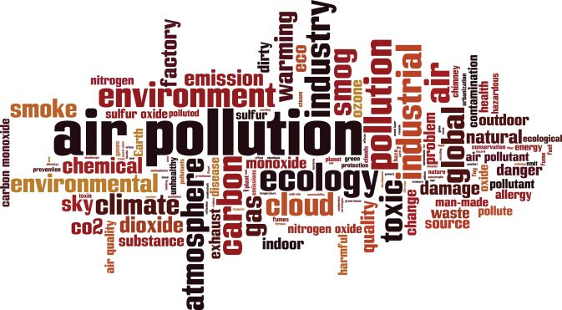
FENCELINE COMMUNITIES
AIR MONITORS – TRAINING –DATA – SOLUTIONS
NAEEMA GILYARD,

Slide 2
CONNECTION
Partnerships and coalitions, that includes communities, municipalities, counties, states and federal agencies, are needed to help achieve Environmental Justice for fence-line communities whose health is compromised by exposure to air pollution and harmful toxins.
Residents in fence-line communities face financial barriers to obtain air monitors with filters for small particles that create data, education for proper use, the potential to analyze the data, and translate the chemical compounds in a report that details the health impacts of environmental stressors.

Slide 3
ASSISTANCE
Assistance from all government agencies could help reduce or remove these barriers
Each entity has a regulation role to play and the responsibility to regulate and
engage in oversight over companies and industries that release toxins into the
atmosphere, They must hold them accountable for their violations based on policies
and laws that are necessary to protect public health.
Government agencies have access to sensitive air monitors.
They have the capabilities to quantify the amount of toxins released by a company
that exceeds allowable thresholds. They are in a position to support the health of
fence-line communities by being more collaborative, transparent, collect air
monitoring data and provide access to that data and its analysis.

Slide 4
SOLUTION
Government’s first priority should be to protect the health of fence-line communities by holding violators of the U.S. EPA Clean Air Act accountable for violations.
Collaboration with fence-line communities to address toxic air releases and
enforcing regulations are good first steps and necessary for not only those
subjected to stressors but also for agencies responsible for adequately addressing
them.

